Slide 1
Process

Slide 2
What is a “process”?
A program in execution
An instance of a program running on a computer
The entity that can be assigned to and executed on a processor
A unit of activity characterized by the execution of a sequence of instructions, a current state, and an associated set of system instructions
Notes:
‹#›

Slide 3
An operating system executes a variety of programs:
Batch system – jobs
Time-shared systems – user programs or tasks
Textbook uses the terms job and process almost interchangeably
Process – a program in execution; process execution must progress in sequential fashion
A process includes:
program counter
stack
data section

Slide 4
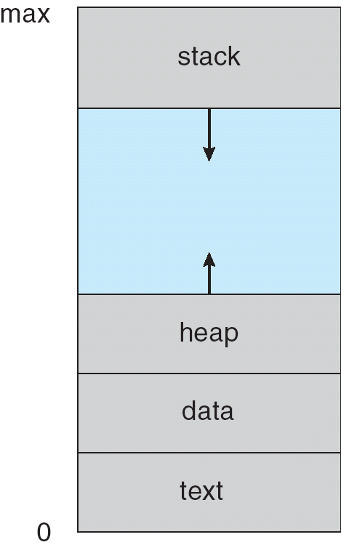
Process in Memory

Slide 5
Process Elements
A process is comprised of:
Program code (possibly shared)
A set of data
A number of attributes describing the state of the process
Notes:
‹#›

Slide 6
Process Elements
While the process is running it has a number of elements including
Identifier
State
Priority
Program counter
Memory pointers
Context data
I/O status information
Accounting information
Notes:
‹#›

Slide 7
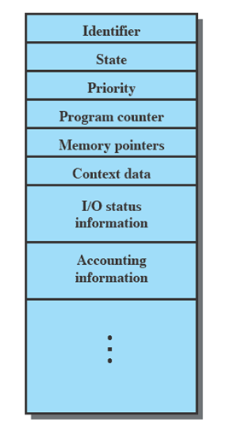
Process Control Block
Contains the process elements
Created and manage by the operating system
Allows support for multiple processes
Notes:
‹#›

Slide 8
Trace - The behavior of an individual process is shown by listing the sequence of instructions that are executed
Dispatcher - is a small program which switches the processor from one process to another
Notes:
‹#›

Slide 9
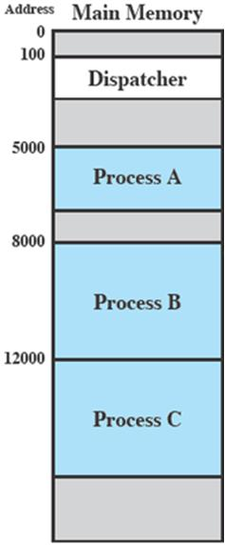
Process Execution
Consider three processes being executed
All are in memory (plus the dispatcher)
Lets ignore virtual memory for this.
Notes:
‹#›

Slide 10
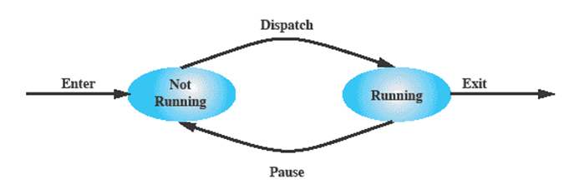
Two-State Process Model
Process may be in one of two states
Running
Not-running
Notes:
‹#›

Slide 11
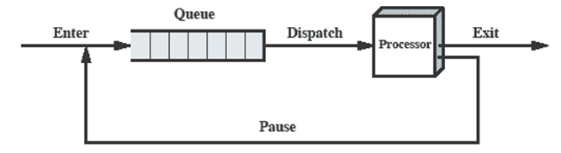
Queuing Diagram
Notes:
‹#›

Slide 12
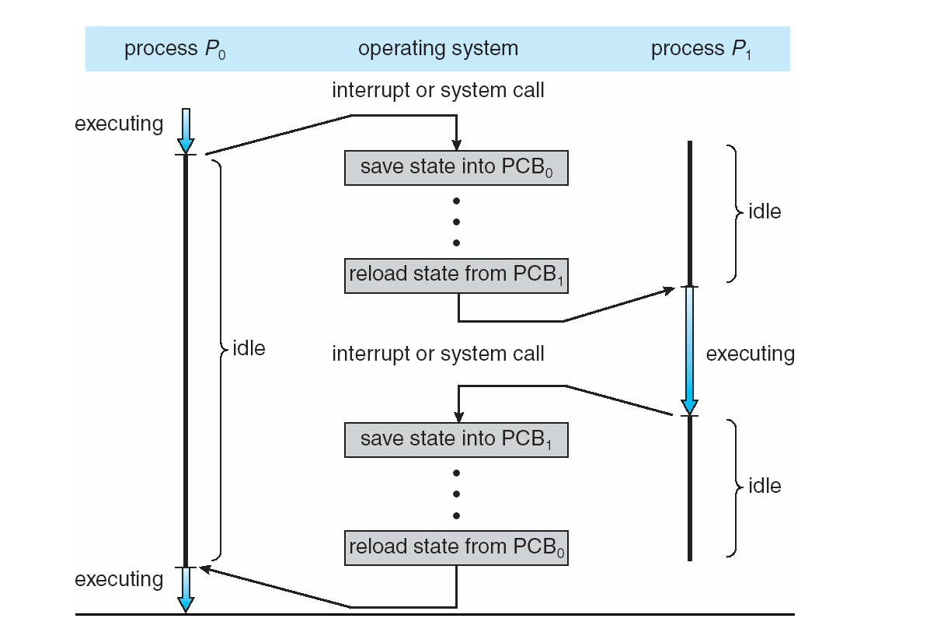
CPU Switch From Process to Process

Slide 13
Process Scheduling
Maximize CPU use, quickly switch processes onto CPU for time sharing
Process scheduler selects among available processes for next execution on CPU
Maintains scheduling queues of processes
Job queue – set of all processes in the system
Ready queue – set of all processes residing in main memory, ready and waiting to execute
Device queues – set of processes waiting for an I/O device
Processes migrate among the various queues

Slide 14
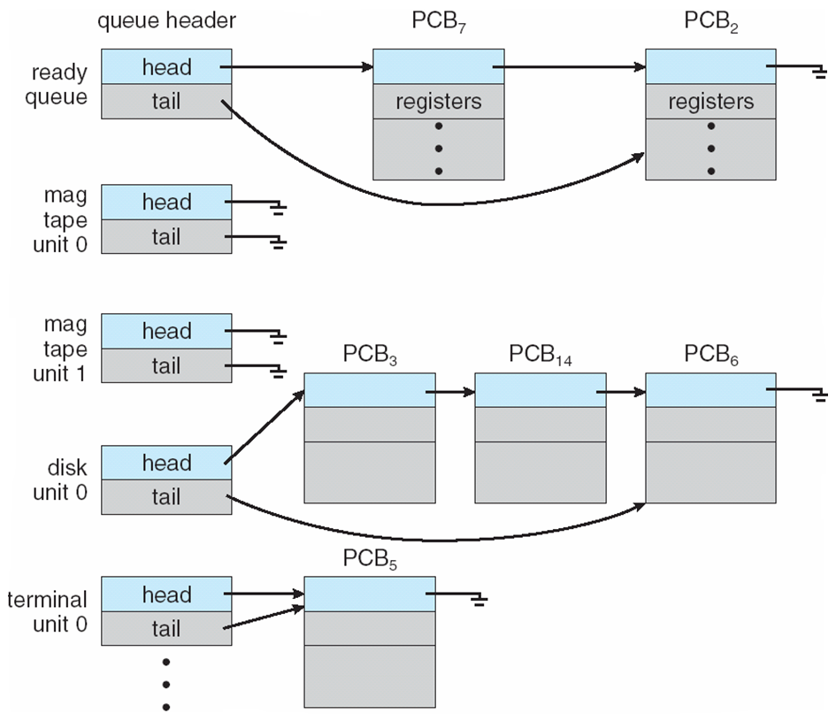
Ready Queue And Various I/O Device Queues

Slide 15
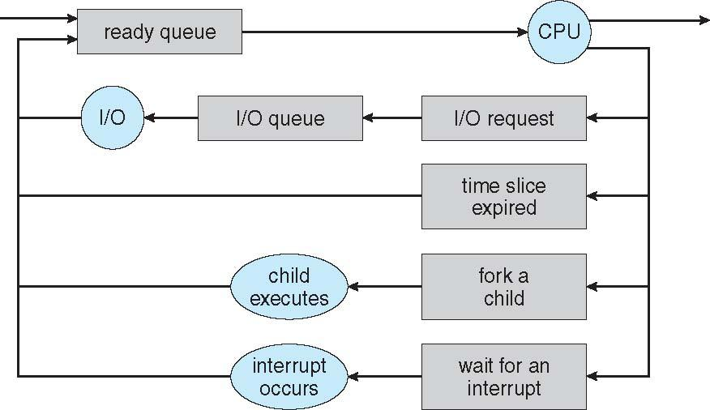
Representation of Process Scheduling

Slide 16
Schedulers
Long-term scheduler (or job scheduler) – selects which processes should be brought into the ready queue
Short-term scheduler (or CPU scheduler) – selects which process should be executed next and allocates CPU
Sometimes the only scheduler in a system

Slide 17
Schedulers (Cont.)
Short-term scheduler is invoked very frequently (milliseconds) ⇒ (must be fast)
Long-term scheduler is invoked very infrequently (seconds, minutes) ⇒ (may be slow)
The long-term scheduler controls the degree of multiprogramming
Processes can be described as either:
I/O-bound process – spends more time doing I/O than computations, many short CPU bursts
CPU-bound process – spends more time doing computations; few very long CPU bursts

Slide 18
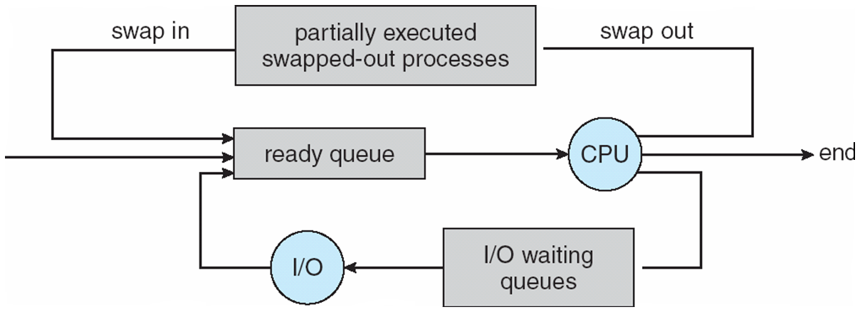
Addition of Medium Term Scheduling

Slide 19
Context Switch
When CPU switches to another process, the system must save the state of the old process and load the saved state for the new process via a context switch.
Context of a process represented in the PCB
Context-switch time is overhead; the system does no useful work while switching
The more complex the OS and the PCB -> longer the context switch
Time dependent on hardware support
Some hardware provides multiple sets of registers per CPU -> multiple contexts loaded at once

Slide 20
Process Birth and Death
Creation | Termination
New batch job | Normal Completion
Interactive Login | Memory unavailable
Created by OS to provide a service | Protection error
Spawned by existing process | Operator or OS Intervention
Notes:
‹#›

Slide 21
Process Creation
The OS builds a data structure to manage the process
Traditionally, the OS creates all processes
But it can be useful to let a running process create another
This action is called process spawning
Parent Process is the original, creating, process
Child Process is the new process
Notes:
‹#›

Slide 22
Parent process create children processes, which, in turn create other processes, forming a tree of processes
Resource sharing
Parent and children share all resources
Children share subset of parent’s resources
Parent and child share no resources
Execution
Parent and children execute concurrently
Parent waits until children terminate

Slide 23
Address space
Child duplicate of parent
Child has a program loaded into it
UNIX examples
fork system call creates new process
exec system call used after a fork to replace the process’ memory space with a new program

Slide 24
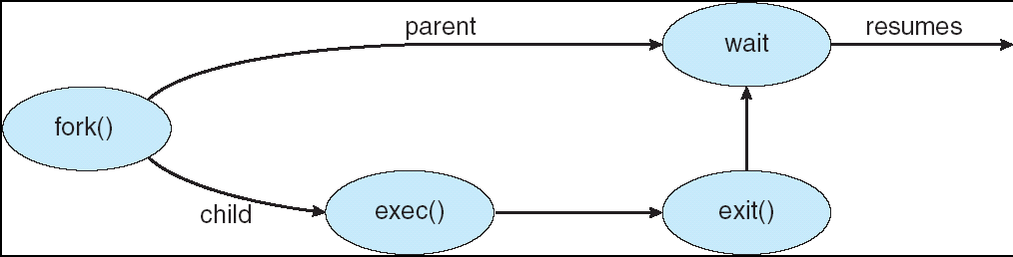

Slide 25
C Program Forking Separate Process
int main()
{
pid_t pid;
/* fork another process */
pid = fork();
if (pid < 0) { /* error occurred */
fprintf(stderr, "Fork Failed");
exit(-1);
}
else if (pid == 0) { /* child process */
execlp("/bin/ls", "ls", NULL);
}
else { /* parent process */
/* parent will wait for the child to complete */
wait (NULL);
printf ("Child Complete");
exit(0);
}
}

Slide 26
Process Termination
There must be some way that a process can indicate completion.
This indication may be:
A HALT instruction generating an interrupt alert to the OS.
A user action (e.g. log off, quitting an application)
A fault or error
Parent process terminating

Slide 27
Process Termination
Process executes last statement and asks the operating system to delete it (exit)
Output data from child to parent (via wait)
Process’ resources are deallocated by operating system
Parent may terminate execution of children processes (abort)
Child has exceeded allocated resources
Task assigned to child is no longer required
If parent is exiting
Some operating system do not allow child to continue if its parent terminates
All children terminated - cascading termination

Slide 28
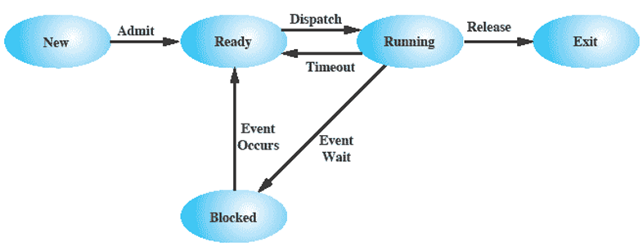
Five-State Process Model
Notes:
‹#›

Slide 29
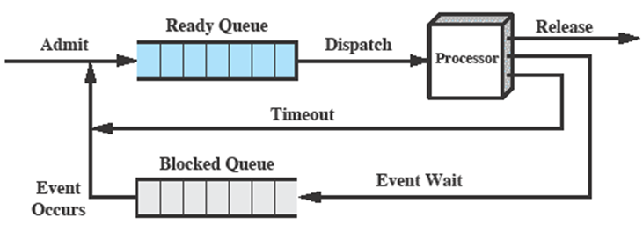
Using Two Queues
- Problem??
Notes:
‹#›

Slide 30
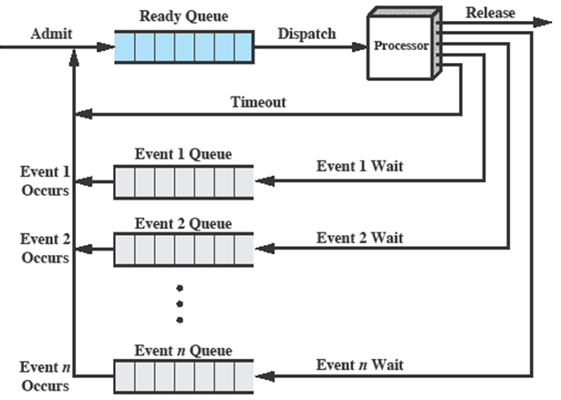
Multiple Blocked Queues
Notes:
‹#›

Slide 31
Suspended Processes
Processor is faster than I/O so all processes could be waiting for I/O
Swap these processes to disk to free up more memory and use processor on more processes(aim??)
Blocked state becomes suspend state when swapped to disk
Two new states
Blocked/Suspend
Ready/Suspend
Notes:
‹#›

Slide 32
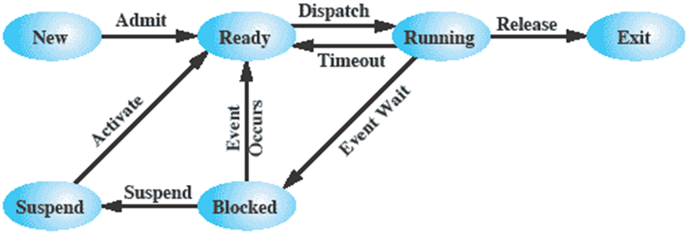
One Suspend State
Notes:
‹#›

Slide 33
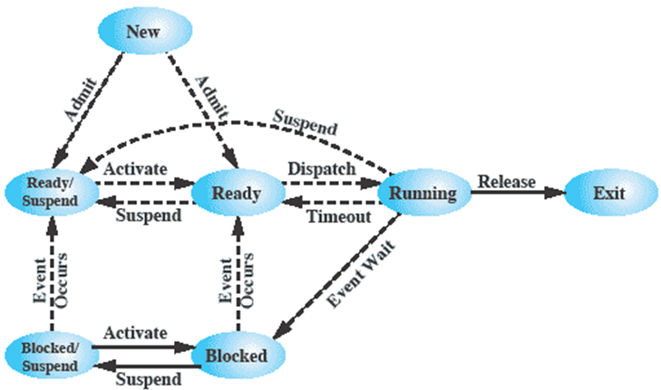
Seven state model of process
Ready: The process is in main memory and available for execution.
Blocked: The process is in main memory and awaiting an event.
Blocked/Suspend: The process is in secondary memory and awaiting an event.
Ready/Suspend: The process is in secondary memory but is available for execution as soon as it is loaded into main memory.
Notes:
‹#›

Slide 34
Reason for Process Suspension
Reason | Comment
Swapping | The OS needs to release sufficient main memory to bring in a process that is ready to execute.
Other OS Reason | OS suspects process of causing a problem.
Interactive User Request | e.g. debugging or in connection with the use of a resource.
Timing | A process may be executed periodically (e.g., an accounting or system monitoring process) and may be suspended while waiting for the next time.
Parent Process Request | A parent process may wish to suspend execution of a descendent to examine or modify the suspended process, or to coordinate the activity of various descendants.
Notes:
‹#›

Slide 35
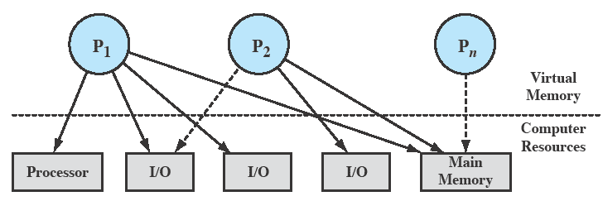
Processes and Resources
OS controls events within the computer system. It schedules and dispatches processes for execution by the processor, allocates resources to processes, and responds to requests by user processes for basic services.
Notes:
‹#›

Slide 36
Operating System Control Structures
For the OS is to manage processes and resources, it must have information about the current status of each process and resource.
Tables are constructed for each entity the operating system manages
Notes:
‹#›

Slide 37
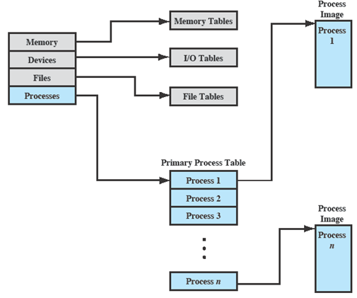
OS Control Tables
Notes:
‹#›

Slide 38
Memory Tables
Memory tables are used to keep track of both main and secondary memory.
Must include this information:
Allocation of main memory to processes
Allocation of secondary memory to processes
Protection attributes for access to shared memory regions
Information needed to manage virtual memory
Notes:
‹#›

Slide 39
I/O Tables
Used by the OS to manage the I/O devices and channels of the computer.
The OS needs to know
Whether the I/O device is available or assigned
The status of I/O operation
The location in main memory being used as the source or destination of the I/O transfer
Notes:
‹#›

Slide 40
File Tables
These tables provide information about:
Existence of files
Location on secondary memory
Current Status
other attributes.
Sometimes this information is maintained by a file management system
Notes:
‹#›

Slide 41
Process Tables
To manage processes the OS needs to know details of the processes
Current state
Process ID
Location in memory
etc
Process control block
Process image is the collection of program. Data, stack, and attributes
Notes:
‹#›

Slide 42
Process Attributes
We can group the process control block information into three general categories:
Process identification
Processor state information
Process control information
Notes:
‹#›

Slide 43
Process Identification
Each process is assigned a unique numeric identifier.
Many of the other tables controlled by the OS may use process identifiers to cross-reference process tables
Notes:
‹#›

Slide 44
Processor State Information
This consists of the contents of processor registers.
User-visible registers
Control and status registers
Stack pointers
Program status word (PSW)
contains status information
Example: the EFLAGS register on Pentium processors
Notes:
‹#›

Slide 45
Process Control Information
This is the additional information needed by the OS to control and coordinate the various active processes.
Notes:
‹#›

Slide 46
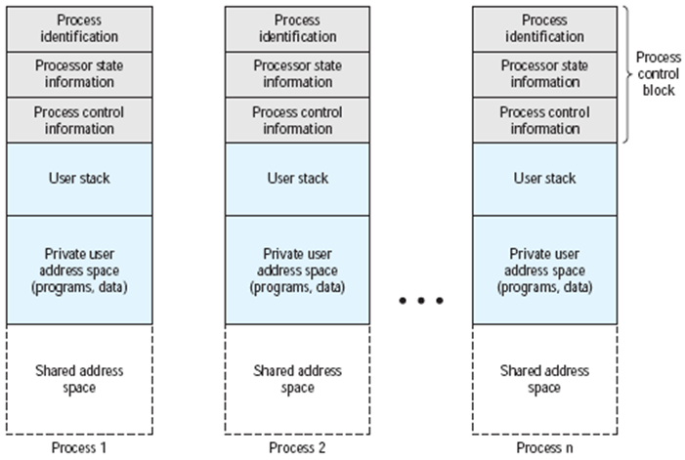
Structure of Process Images in Virtual Memory
Notes:
‹#›

Slide 47
Role of the Process Control Block
The most important data structure in an OS
It defines the state of the OS
Process Control Block requires protection
A faulty routine could cause damage to the block destroying the OS’s ability to manage the process
Any design change to the block could affect many modules of the OS
Notes:
‹#›

Slide 48
Modes of Execution
Most processors support at least two modes of execution
User mode
Less-privileged mode
User programs typically execute in this mode
System mode
More-privileged mode
Kernel of the operating system
Notes:
‹#›

Slide 49
Process Creation
Once the OS decides to create a new process it:
Assigns a unique process identifier
Allocates space for the process
Initializes process control block
Sets up appropriate linkages
Creates or expand other data structures
Notes:
‹#›

Slide 50
Switching Processes
Several design issues are raised regarding process switching
What events trigger a process switch?
We must distinguish between mode switching and process switching.
What must the OS do to the various data structures under its control to achieve a process switch?

Slide 51
When to switch processes
A process switch may occur any time that the OS has gained control from the currently running process. Possible events giving OS control are:
Mechanism | Cause | Use
Interrupt | External to the execution of the current instruction | Reaction to an asynchronous external event
Trap | Associated with the execution of the current instruction | Handling of an error or an exception condition
Supervisor call | Explicit request | Call to an operating system function
Notes:
‹#›

Slide 52
Change of Process State …
The steps in a process switch are:
Save context of processor including program counter and other registers
Update the process control block of the process that is currently in the Running state
Move process control block to appropriate queue – ready; blocked; ready/suspend
Notes:
‹#›

Slide 53
Change of Process State cont…
Select another process for execution
Update the process control block of the process selected
Update memory-management data structures
Restore context of the selected process
Notes:
‹#›

Slide 54
Is the OS a Process?
If the OS is just a collection of programs and if it is executed by the processor just like any other program, is the OS a process?
If so, how is it controlled?
Who (what) controls it?
Notes:
‹#›

Slide 55
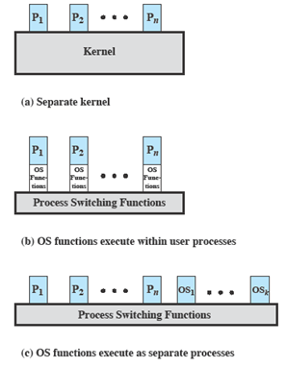
Execution of the Operating System
Notes:
‹#›

Slide 56
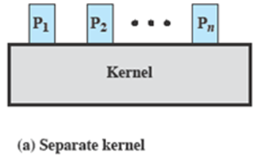
Non-process Kernel
Execute kernel outside of any process
The concept of process is considered to apply only to user programs
Operating system code is executed as a separate entity that operates in privileged mode
Notes:
‹#›

Slide 57
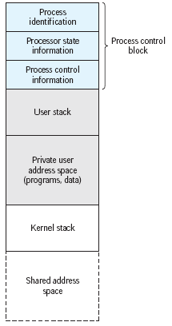
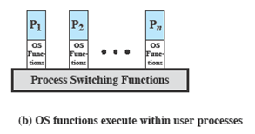
Execution Within User Processes
Execution Within User Processes
Operating system software within context of a user process
No need for Process Switch to run OS routine
Notes:
‹#›

Slide 58
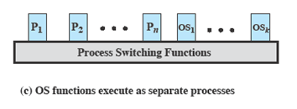
Process-based Operating System
Process-based operating system
Implement the OS as a collection of system process
Notes:
‹#›

Slide 59
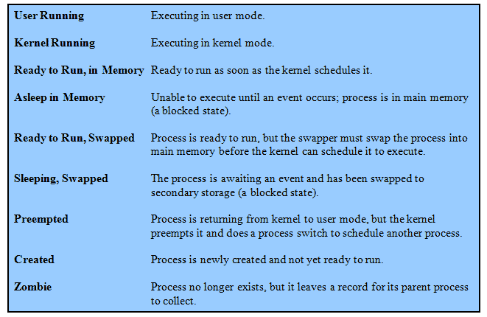
UNIX Process States
Notes:
‹#›

Slide 60
A Unix Process
A process in UNIX is a set of data structures that provide the OS with all of the information necessary to manage and dispatch processes.
The elements are in three parts:
user-level context,
register context, and
system-level context.
Notes:
‹#›

Slide 61
Process Creation
Process creation is by means of the kernel system call,fork( ).
This causes the OS, in Kernel Mode, to:
Allocate a slot in the process table for the new process.
Assign a unique process ID to the child process.
Copy of process image of the parent, with the exception of any shared memory.
Notes:
‹#›

Slide 62
Process Creation cont…
Increment the counters for any files owned by the parent, to reflect that an additional process now also owns those files.
Assign the child process to the Ready to Run state.
Returns the ID number of the child to the parent process, and a 0 value to the child process.
Notes:
‹#›

Slide 63
After Creation
After creating the process the Kernel can do one of the following, as part of the dispatcher routine:
Stay in the parent process.
Transfer control to the child process
Transfer control to another process.
Notes:
‹#›

